Slide 1
CMSC204
Kartchner
V(StateGraph) = {Oregon, Alaska, Texas, Hawaii, Vermont, NewYork, California}
E(StateGraph) = {(Alaska, Oregon), (Hawaii, Alaska), (Hawaii, Texas), (Texas, Hawaii), (Hawaii, California), (Hawaii, New York), (Texas, Vermont), (Vermont, California), (Vermont, Alaska)}
1. Draw the StateGraph
Alaska
Oregon
New York
Hawaii
Texas
California
Vermont
{Oregon, Alaska, Texas, Hawaii, Vermont, New York, California}
{(Alaska, Oregon), (Hawaii, Alaska), (Hawaii, Texas),
(Texas, Hawaii), (Hawaii, California), (Hawaii, New York), (Texas, Vermont),
(Vermont, California), (Vermont, Alaska)}
No
Yes
Texas

Slide 2
a. Show the adjacency matrix that would describe the edges in the graph. Store the vertices in alphabetical order
States
Alaska California Hawaii New York Oregon Texas Vermont
0
0
0
0
1
0
0
Alaska
California
Hawaii
New York
Oregon
Texas
Vermont
0
0
0
0
0
0
0
1
1
0
1
0
1
0
0
0
0
0
0
0
0
0
0
0
0
0
0
0
0
0
1
0
0
0
1
1
1
0
0
0
0
0
3. b. Show the adjacency lists
that would describe the edges in the graph
Oregon
Alaska
California
Hawaii
New York
Oregon
Texas
Vermont
Alaska → California → New York → Texas
Hawaii → Vermont
Alaska → California

Slide 3
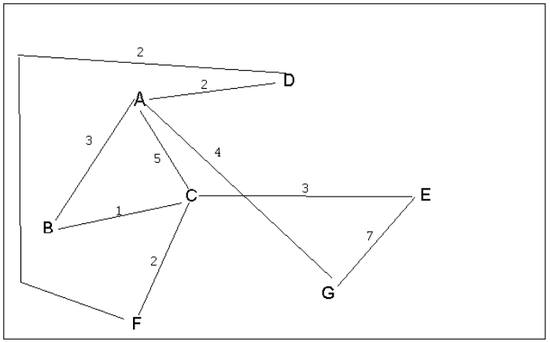
4 a. Which of the following lists the graph nodes in depth first order beginning with E?
A) E, G, F, C, D, B, A
B) G, A, E, C, B, F, D
C) E, G, A, D, F, C, B
D) E, C, F, B, A, D, G
4 b. Which of the following lists the graph nodes in breadth first order beginning at F?
A) F, C, D, A, B, E, G
B) F, D, C, A, B, C, G
C) F, C, D, B, G, A, E
D) a, b, and c are all breadth first traversals

Slide 4
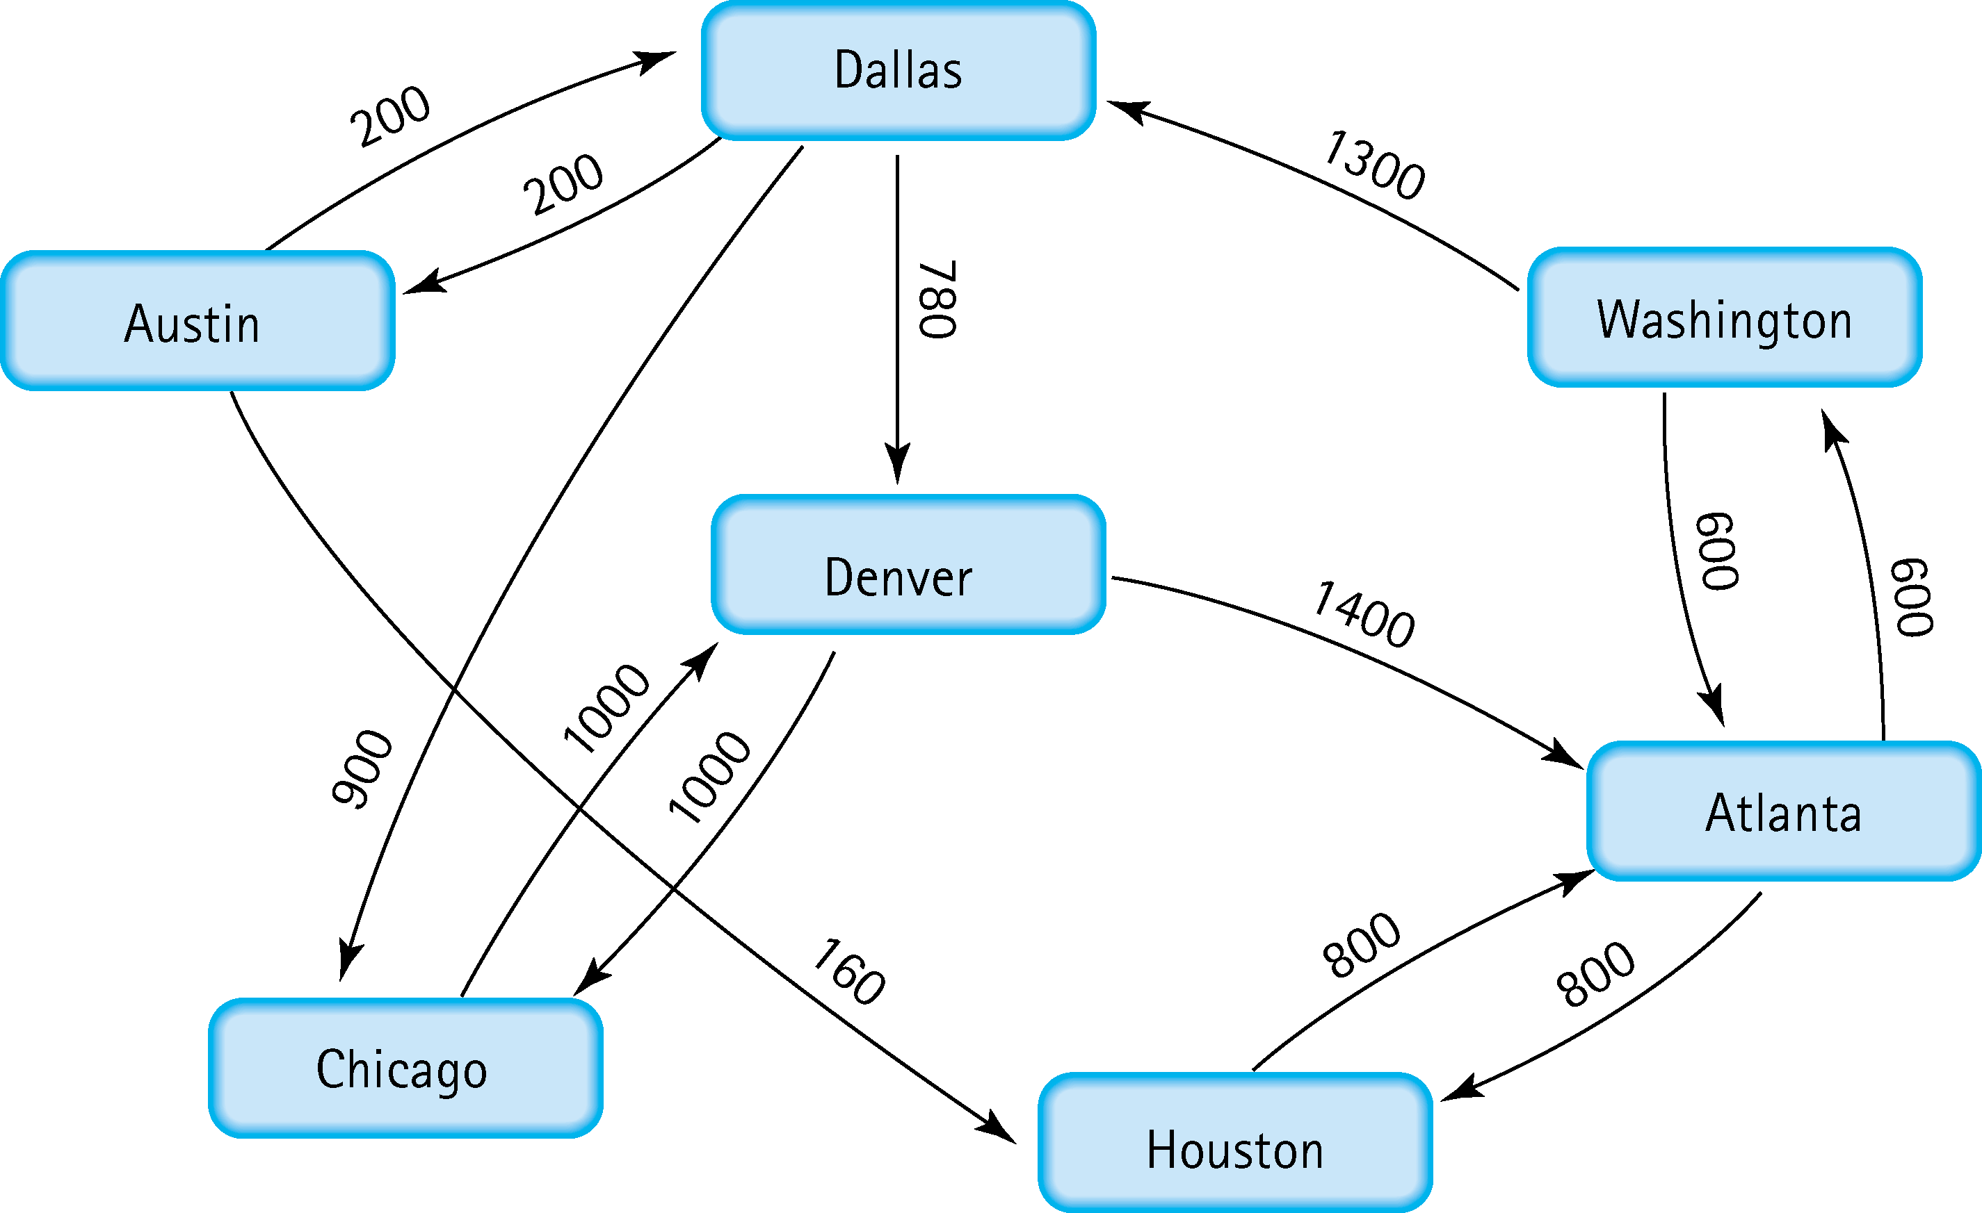
5. Find the shortest distance from Atlanta to every other city
Atlanta → Washington: 600
Atlanta → Houston: 800
Atlanta → Dallas: 1900
Atlanta → Denver: 2680
Atlanta → Austin: 2100
Atlanta → Chicago: 2800

Slide 5
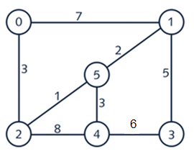
6. Find the minimal spanning tree using Prim’s algorithm. Use
0 as the source vertex . Show the steps.
Let V(g) denotes the set of vertices and E(g) denotes the set of edges in the minimum
spanning tree.
V(g) = {0}, E(g) = {}
V(g) = {0,2}, E(g) = {(0,2)}
V(g) = {0,2,5}, E(g) = {(0,2),{2,5)}
V(g) = {0,2,5,1}, E(g) = {(0,2),{2,5),(5,1)}
V(g) = {0,2,5,1,4}, E(g) = {(0,2),{2,5),(5,1),(5,4)}
V (g) = {0,2,5,1,4,3}, E(g) = {(0,2),{2,5),(5,1),(5,4),(1,3)}
0
1
2
3
5
5
1
3
2
4
3

Slide 6
7. Find the minimal spanning tree using Kruskal’s algorithm.
Show the weights in order and the steps.
4. E(g) = {2-5,1-5,0-2,5-4}
V(g) = {2,5,1,0,4}
5. E(g) = {2-5,1-5,0-2,5-4,1-3}
V(g) = {2,5,1,0,4,3}
Sorted edges in ascending
order by weight
2-5(1)
1-5(2)
0-2(3)
5-4(3)
1-3(5)
3-4(6)
0-1(7)
2-4(8)
Let E(g) denotes the set of edges
and V(g) denotes the vertices in
minimum spanning tree
Minimum spanning tree:
1. E(g) = {2-5}
V(g) = {2,5}
2. E(g) = {2-5,1-5}
V(g) = {2,5,1}
3. E(g) = {2-5,1-5,0-2}
V(g) = {2,5,1,0}

Slide 7
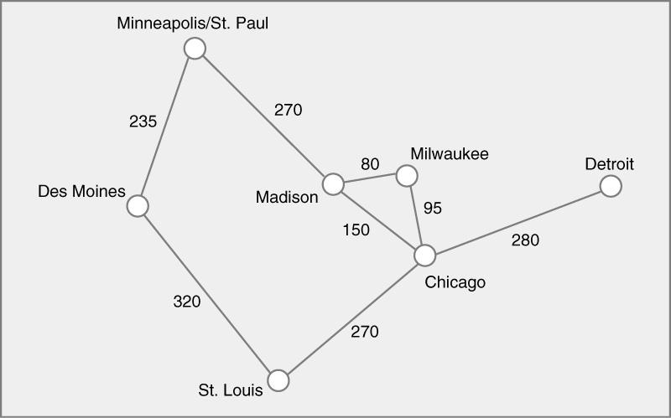
8. Find the minimal spanning tree using the algorithm you prefer. Use
Minneapolis/St. Paul as the source vertex
Let V(g) denotes the set of vertices and E(g) denotes the set of edges in the minimum
spanning tree.
V(g) = {Minneapolis/St. Paul} E(g) = {}
V(g) = {Minneapolis/St. Paul, Des Moines} E(g) = {(Minneapolis/St. Paul, Des Moines)}
V(g) = {Minneapolis/St. Paul, Des Moines, Madison} E(g) = {(Minneapolis/St. Paul, Des Moines), (Minneapolis/St. Paul, Madison)}
V(g) = {Minneapolis/St. Paul, Des Moines, Madison, Milwaukee} E(g) = {(Minneapolis/St. Paul, Des Moines), (Minneapolis/St. Paul, Madison),(Madison, Milwaukee)}
V(g) = {Minneapolis/St. Paul, Des Moines, Madison, Milwaukee, Chicago} E(g) = {(Minneapolis/St. Paul, Des Moines), (Minneapolis/St. Paul, Madison), (Madison, Milwaukee),(Milwaukee, Chicago)}
V(g) = {Minneapolis/St. Paul, Des Moines, Madison, Milwaukee, Chicago, St. Louis} E(g) = {(Minneapolis/St. Paul, Des Moines), (Minneapolis/St. Paul, Madison), (Madison, Milwaukee),(Milwaukee, Chicago), (Chicago, St. Louis)}
V(g) = {Minneapolis/St. Paul, Des Moines, Madison, Milwaukee, Chicago, St. Louis, Detroit} E(g) = {(Minneapolis/St. Paul, Des Moines), (Minneapolis/St. Paul, Madison), (Madison, Milwaukee),(Milwaukee, Chicago), (Chicago, St. Louis), (Chicago, Detroit)}

Slide 8
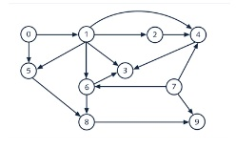
9. List the nodes of the graph in a breadth first topological ordering. Show the
steps using arrays predCount, topologicalOrder and a queue
predCount = [0,1,1,3,3,2,2,0,2,2] topologicalOrder = [] queue = [0,7]
predCount = [0,0,1,3,2,1,1,0,2,1] topologicalOrder = [0,7] queue = [1]
predCount = [0,0,0,2,1,0,0,0,2,1] topologicalOrder = [0,7,1] queue = [2,5,6]
predCount = [0,0,0,2,0,0,0,0,2,1] topologicalOrder = [0,7,1,2] queue = [5,6,4]
predCount = [0,0,0,1,0,0,0,0,0,1] topologicalOrder = [0,7,1,2,5,6] queue = [4,8]
predCount = [0,0,0,0,0,0,0,0,0,1] topologicalOrder = [0,7,1,2,5,6,4] queue = [8,3]
predCount = [0,0,0,0,0,0,0,0,0,0] topologicalOrder = [0,7,1,2,5,6,4,8] queue = [3,9]
predCount = [0,0,0,0,0,0,0,0,0,0] topologicalOrder = [0,7,1,2,5,6,4,8,3,9] queue = []

Slide 9

10. List the nodes of the graph in a breadth first topological ordering.
Start, discrete Math, Programming 1, Computer Organization, Programming 2, Operating
Systems, Algorithms, High-level Languages, Compilers, Theory of Computation, Senior
Seminar, End

